Slide 1



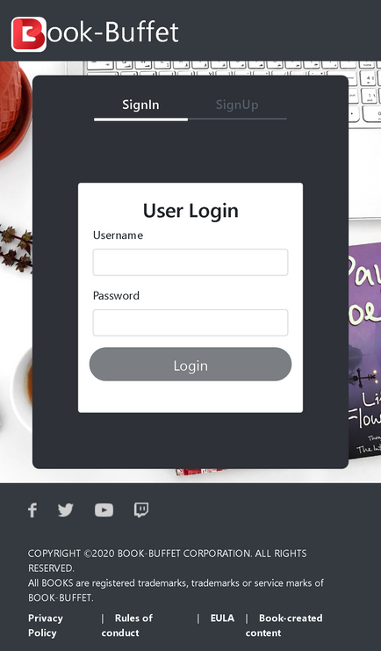

Capstone Project:
Supply Chain Data Engineering & Analytics
on Azure Cloud
Team 3
Janani M S
Pandi Vaishnavi
Prerana P
Shruthi G
Sukitha M

Slide 2
Introduction
Project Objectives
Project Datasets
Project Flow
Phase 1: SDLC Documentation & System Design (SRS,HLD, UML)
Phase 2: Data Engineering with Python & SQL
Phase 3: FastAPI Development for Supply Chain Metrics
Phase 4: Azure Cloud Integration (ADLS, ADF)
Technology and Tools Used
Conclusion
Outline

Slide 3
Introduction
The Book-Buffet app helps the user to read books online. It also helps user to
store the favourite books and delete them afterwards.
Global supply chains are complex and face challenges like delays, stockouts, and claim disputes that increase costs.
Enterprises require cloud-first platforms to consolidate shipment, inventory, delivery, and claim data for better visibility and performance.
This pro simulates a cloud-native analytics platform with pipelines, REST APIs, and Azure integration to track orders, inventory, deliveries, and claims.

Slide 4

Define system design and data flow using SDLC, SRS, HLD, and UML.
Use SQL and Pandas for data cleaning, transformation, and summarization.
Build FastAPI microservices for delivery status, inventory health, and claims.
Integrate data with Azure Data Lake, Data Factory, and Synapse pipelines.
Visualize KPIs like delivery trends, stock levels, and claim status via dashboards.
Project Objectives

Slide 5
Project Datasets
1.Shipments Table: shipment_id, origin_warehouse, destination_city, ship_date, delivery_date, product_id, quantity, freight_cost
2.Vendors Table: vendor_id, vendor_name, product_id, contract_start, contract_end, vendor_rating, country
3.Inventory Table: warehouse_id, product_id, stock_level, reorder_threshold, last_restock_date, next_restock_due
4.Delivery Logs Table: delivery_id, shipment_id, carrier, status, delivery_duration_days, damage_flag, proof_of_delivery_status
5.Claims Table: claim_id, delivery_id, reason, amount_claimed, claim_status, claim_date, resolved_date
Relationships:
shipment_id links Shipments and Delivery Logs
delivery_id links Delivery Logs and Claims
product_id links Vendors, Shipments, and Inventory

Slide 6
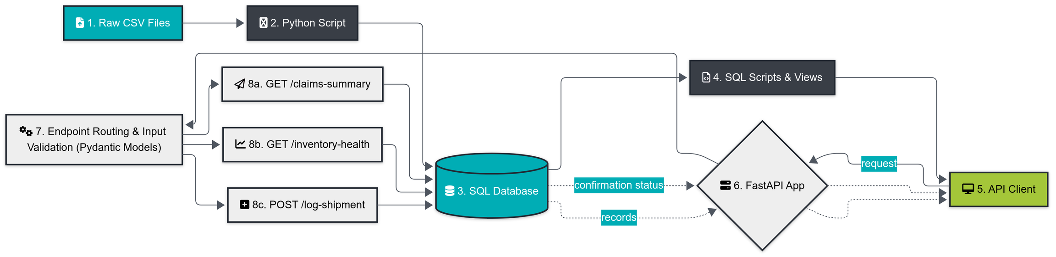
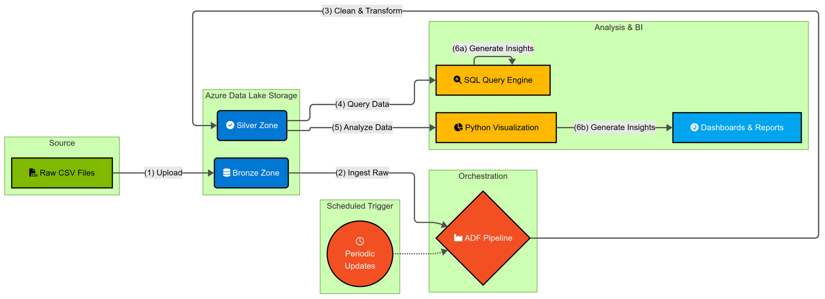
Project Flow
The Book-Buffet app helps the user to read books online. It also helps user to
store the favourite books and delete them afterwards.

Slide 7
Draft SRS for a cloud supply chain platform with shipment tracking and claim summaries
- Document business and functional requirements
Create HLD showing system modules:
- Shipment Tracker
- Claims Monitor
- Vendor Inventory Viewer
Design UML Diagrams:
- Use Case Diagram: Initiate shipment, file a claim,check inventory
- Class Diagram: Shipment, Vendor, Inventory entities.
- Activity Diagram: Claim resolution workflow.
Phase 1: SDLC Documentation & System Design (SRS, HLD, UML)

Slide 8
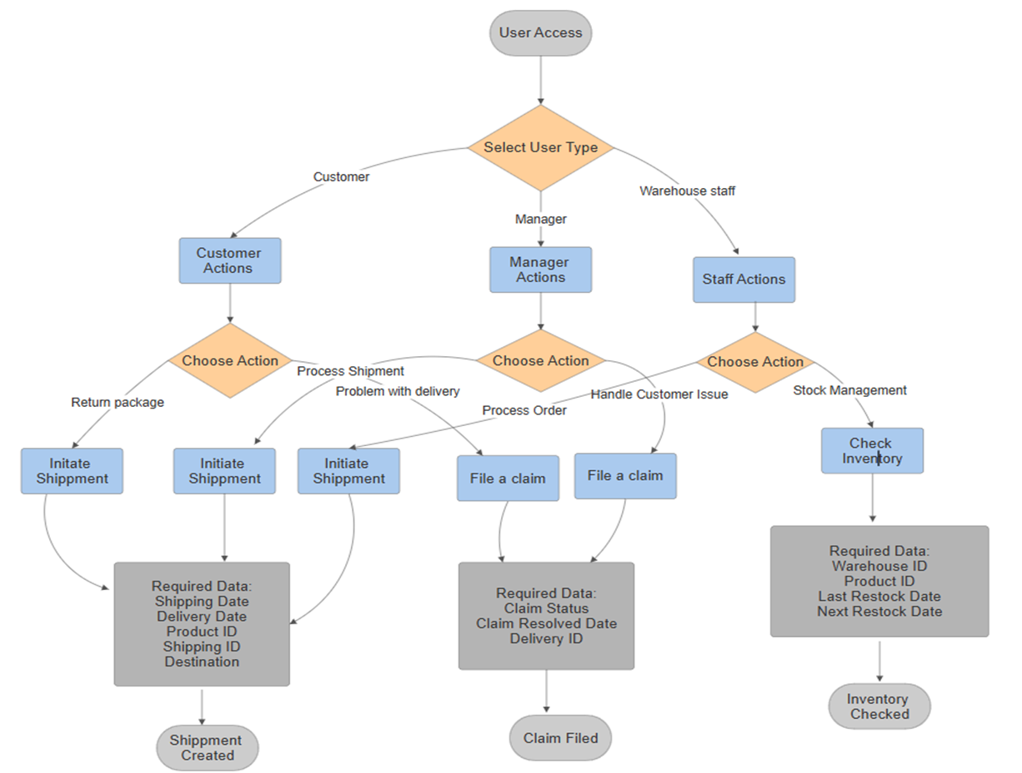

Phase 1: Usecase Diagram & SRS
SRS Document

Slide 9
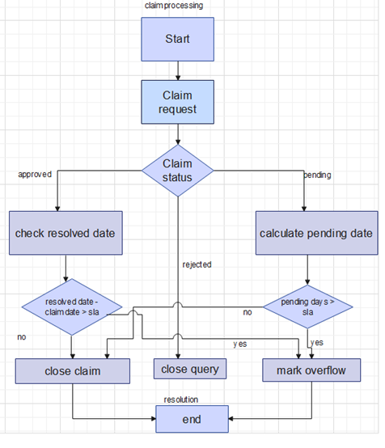
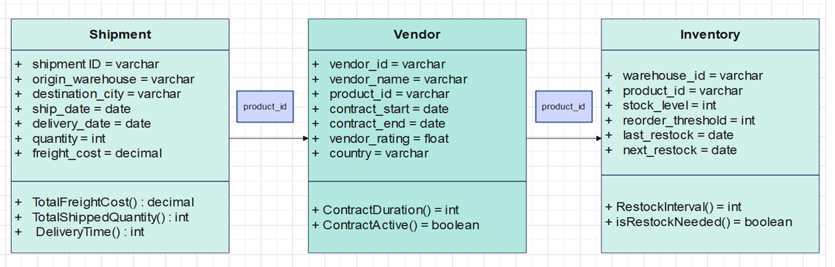
Phase 1: Class and Activity Diagram

Slide 10
HLD
The Book-Buffet app helps the user to read books online. It also helps user to
store the favourite books and delete them afterwards.

Slide 11
Phase 2: Data Engineering with Python & SQL
Use Python with Pandas to:
- Clean and merge shipment, delivery, and claim data.
- Calculate delay duration, reorder flags, claim aging.
Write SQL scripts for:
- Joins across shipment–delivery–claim tables.
- Aggregate freight costs by city, average claim amounts.
-Grouped summaries by carrier or vendor
Use Views and Subqueries for reporting stock health or unresolved claims.

Slide 12
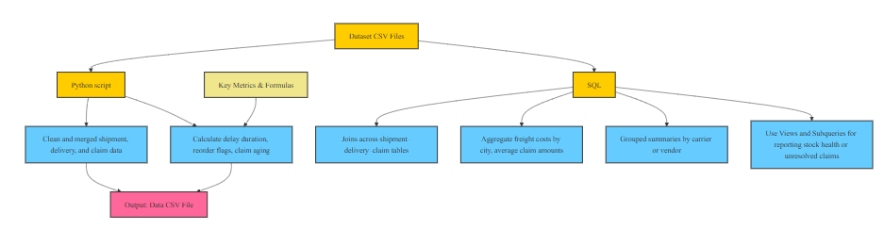
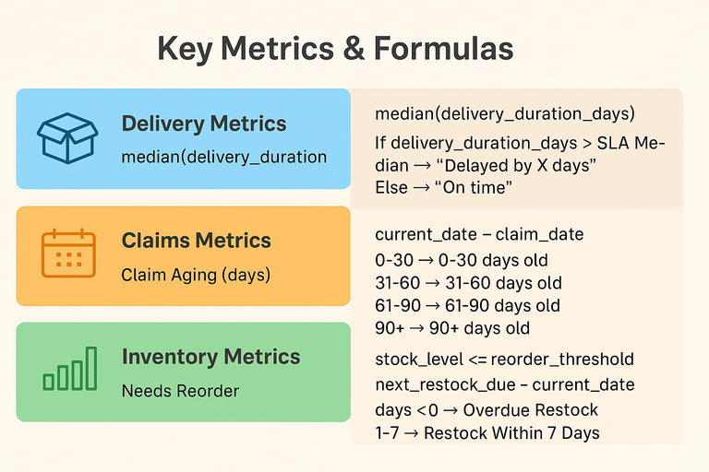

Phase 2: Data Engineering with Python & SQL
Phase 2

Slide 13
Phase 3: FastAPI Development for Supply Chain Metrics
Develop FastAPI microservices:
- GET /claims-summary → Return claim percentages per carrier.
- GET /inventory-health → Return stock and reorder status.
- POST /log-shipment → Add a new shipment record.
Integrate SQLAlchemy + Pydantic models.
Enable file upload APIs to import new delivery logs.
Expose automatic docs via Swagger/Redoc.

Slide 14
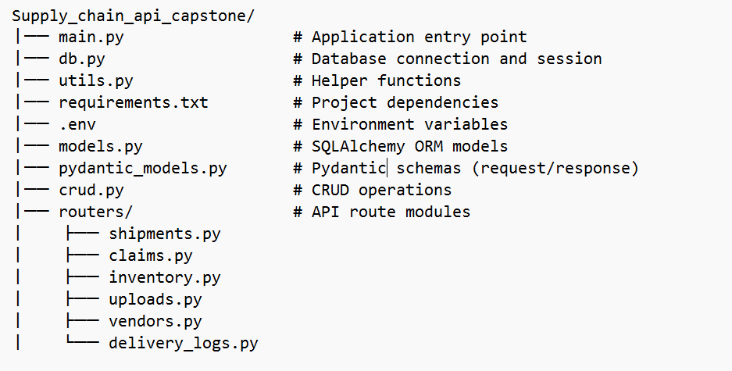
Phase 3: FastAPI Development for Supply Chain Metrics
Phase 3

Slide 15
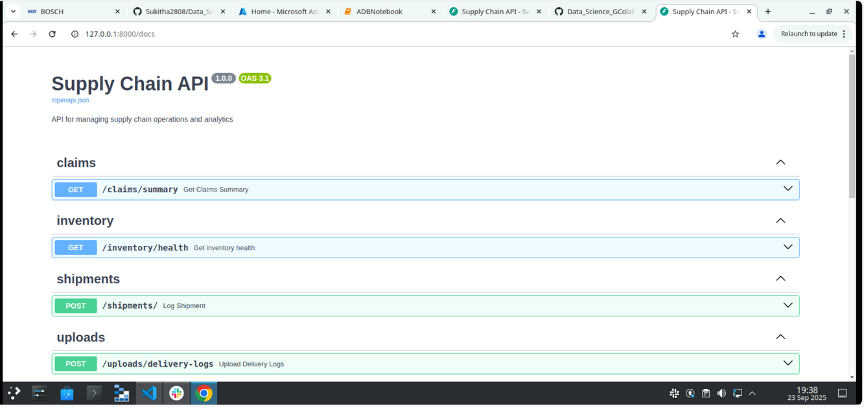
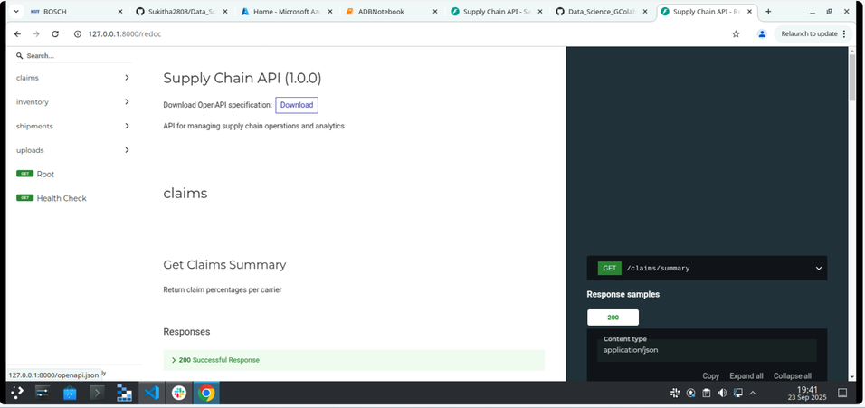
Phase 3: FastAPI Development for Supply Chain Metrics

Slide 16
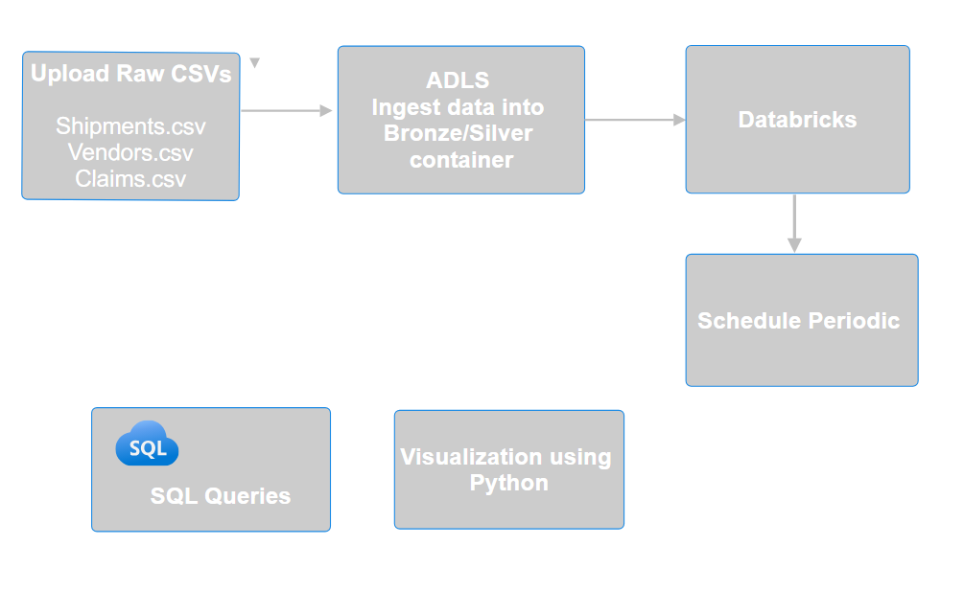
Phase 4: Azure Cloud Integration (ADLS, ADF)
Phase 4

Slide 17
Phase 4: Azure Cloud Integration (ADLS, ADF)

Slide 18

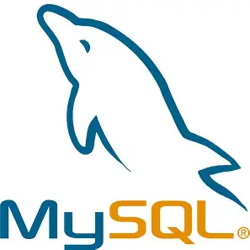
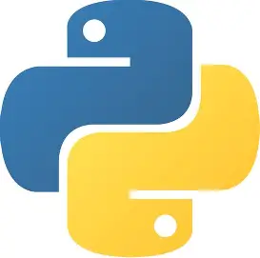

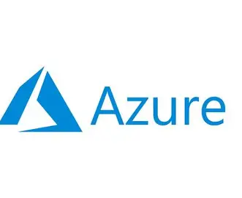
Technologies and Tools Used

Slide 19
Conclusion
The Book-Buffet app helps the user to read books online. It also helps user to
store the favourite books and delete them afterwards.
The project showcases the successful simulation of a cloud-native supply chain analytics platform, achieving data integration, real-time APIs, and KPI visualization to improve operational insight.
Future work can extend this foundation by scaling pipelines, enhancing predictive analytics, and integrating with live enterprise systems for end-to-end supply chain optimization.

Slide 20
Thank You

Slide 21

Any Questions ?

